Slide 1
Virat Kohli: A Global Cricketing Icon
A Presentation on Virat Kohli

Slide 2
Presentation Overview
Introduce Virat Kohli as a prominent Indian international cricketer.
Discuss his significant role as the former captain of the national team.
Highlight his distinctive playing style as a right-handed batsman.
Explore his representation in domestic and IPL cricket.
Summarize the vast resources available for his career statistics and records.

Slide 3
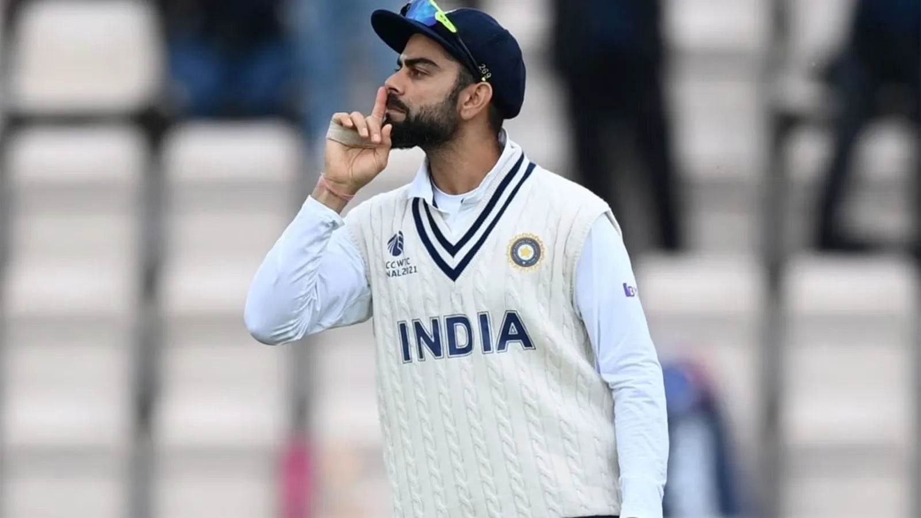
An Indian International & Captaincy Legacy
Virat Kohli is a celebrated Indian international cricketer.
He has proudly represented India on the global stage for many years.
Kohli also served as the former captain of the Indian national cricket team.
His leadership era saw significant achievements and records for the team.

Slide 4
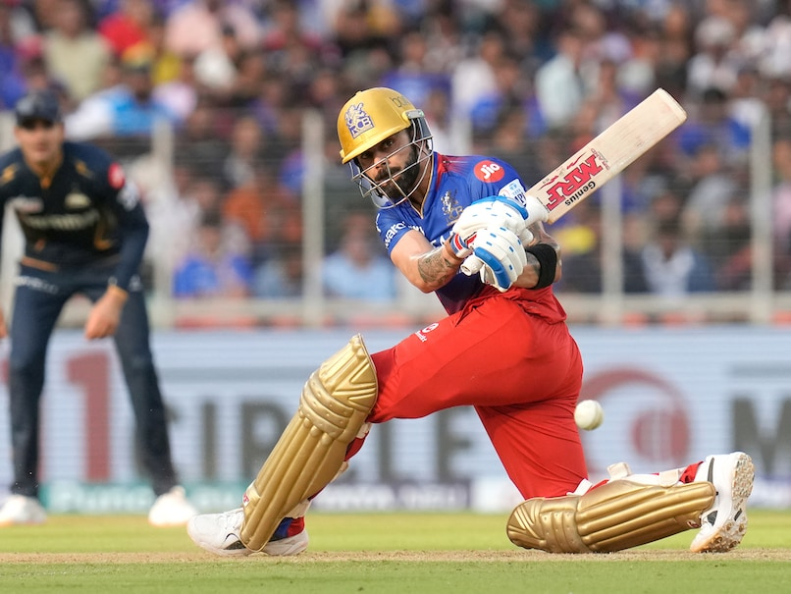
Batting Prowess and Versatility
He is renowned as a highly skilled right-handed batsman.
Kohli's batting style is characterized by aggressive yet controlled strokeplay.
Beyond batting, he also contributes as an occasional medium-pace bowler.
This versatility adds another dimension to his all-round cricketing abilities.

Slide 5
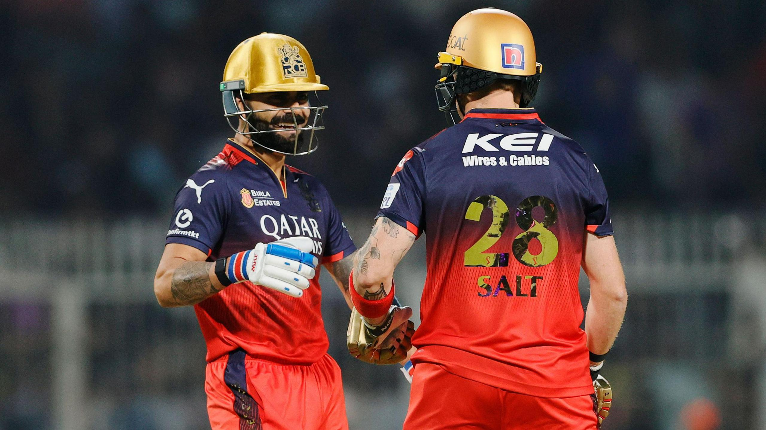
Domestic and Franchise Contributions
Virat Kohli actively participates in India's domestic cricket circuit.
He currently represents Delhi in first-class and other domestic formats.
In the Indian Premier League (IPL), he is a long-standing fixture for Royal Challengers Bengaluru.
His dedication to both domestic and franchise cricket showcases his consistent involvement in the sport.

Slide 6
A Career Documented: Stats, Rankings, Records
Virat Kohli's extensive career is meticulously documented across various platforms.
Fans and analysts can access detailed profiles, statistics, and rankings on sites like ESPNcricinfo.
His numerous records and milestones are a testament to his consistent performance.
Comprehensive resources include videos and photos, offering a deep dive into his cricketing journey.

Slide 7
The Enduring Legacy of Virat Kohli
Virat Kohli stands as one of the most influential and successful cricketers globally.
His impact extends from leading the Indian team to setting remarkable batting records.
He continues to inspire millions through his dedication and prowess in both international and domestic cricket.
Kohli's career provides a rich tapestry of statistics, achievements, and memorable moments for fans worldwide.

